Slide 1
IOT
Hands-On 6

Slide 2
Hands-On #6
Goals:
Create GUI App based on PyQt5
Create client session to White Cube server
Create continuous subscriber session
Implement even handler based on sensor’s data (e.g. send email, enable sound alarm)
Control white-cube devices

Slide 3
Steps TODO:
Create GUI included next functionality:
Changing broker IP, port
Changing Running time
Topic change
Client name change
Username and Password
Indicating connection status
Create client to White Cube broker server
Define event handler for one cube from set (Button, DHT, Light, Reed, Relay)
Create reaction to event handler

Slide 4
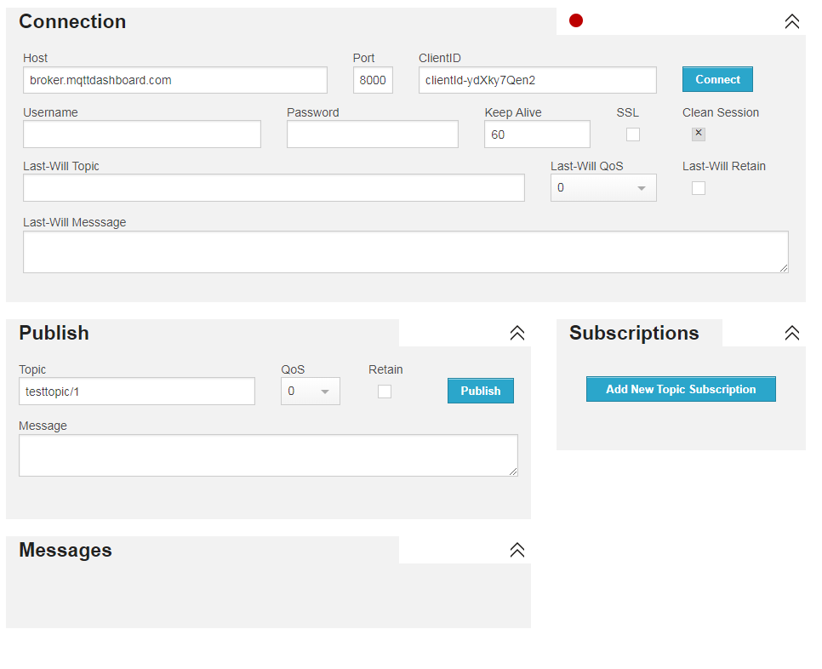
GUI show reference

Slide 5
TODO
Use next GUI example file:
Gui_main.py
Example_connect.py
Gui_helpers.py
IOT_MQ_main.py
Useful link: http://zetcode.com/gui/pyqt5/

